Slide 1
Basic SQL queries
PHP web development 2020/2021
https://vratsasoftware.com/
Vratsa Software

Slide 2
Table of contents
Create INSERT INTO
Read SELECT
Update UPDATE table SET …
Delete DELETE FROM table …
Basic to advanced (optional):
LIMIT, SKIP, ORDER_BY, GROUP_BY, HAVING

Slide 3
1. Create record in DB
Syntax:
INSERT INTO table_name (column_1,column_2,….)
VALUES (value_1, value_2, ….)
Quotes & backticks rules:
When to use backticks ` `
When to use single quotes ‘ ‘
When to use double quotes “ ”
When not to use quotes or backticks
MySQL reserved words:
Examples:
`INDEX`, `OPTION`, `DAY`, ` DATETIME`, ……
https://dev.mysql.com/doc/refman/8.0/en/keywords.html

Slide 4
2. Read (retrieve) information from DB
Basic Syntax:
SELECT * FROM table_name
Note: Asterisk character * means get all fields/columns
Specify column(field) names:
SELECT column_1,column_2,…. FROM table_name
Add condition (where clause):
SELECT column_1,column_2,…. FROM table_name WHERE expression

Slide 5
Notes
Using WHERE to get a range of values or filter results
Comparison operators in WHERE clause:
= , < , > , >= , <= , <>, !=
Multiple WHERE conditions
- AND operator, OR operator;
Combining AND & OR operators
Example
SELECT `recipe_name`, `prep_time` FROM `recipes` WHERE `date_deleted` IS NULL AND (`recipe_name` = 'Mexican Sandwich' OR `recipe_name`= 'Spring Rolls')

Slide 6
3. Update record or records
Syntax:
UPDATE table_name
SET column_1 = value_1, column_2 = value_2, ….
WHERE expression
* Always use proper where clause or all rows will be updated !
* WHERE expression - the same rules applies as in previous slide
Example:
UPDATE `recipes` SET `prep_time` = 30, `prep_description` = 'Mix the meat with the marinade ingredients and set aside for about 30 minutes' WHERE `recipe_name` = 'Spring Rolls'

Slide 7
4. Delete record or records from DB
Syntax:
DELETE FROM table_name
WHERE expression
* Always use proper where clause. If you omit the WHERE clause, all records in the table will be deleted !!!
Example:
DELETE FROM `recipes` WHERE `recipe_name` = Mexican Sandwich'

Slide 8
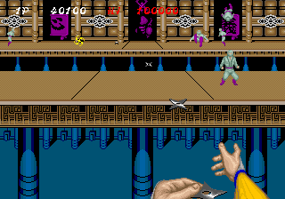

5. Basic to Advanced

Slide 9

5.1 ORDER BY
The SQL ORDER BY clause is used to sort the records in the result set for a SELECT statement
Syntax:
SELECT column_1,column_2,…. FROM table_name
WHERE expression
ORDER_BY column_x [ ASC | DESC ] , column_y [ ASC | DESC ]

Slide 10

5.2 “LIKE” - use pattern in WHERE clause
The LIKE operator is a logical operator that tests whether a string contains a specified pattern or not. Here is the syntax of the LIKE operator:
The LIKE operator is a logical operator that tests whether a string contains a specified pattern or not.
Wildcards:
% - matches any string of zero or more characters;
_ - matches any single character;
SELECT column_1,column_2,…. FROM table_name WHERE column_1 LIKE ‘%S_ring%’
For example, code above will return any row with column_1 contains ‘Beautiful Spring’ or ‘String’

Slide 11
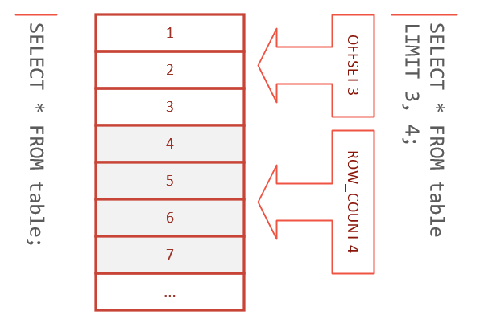
5.3 “LIMIT” and OFFSET
The limit keyword is used to limit the number of rows returned in a query result.
Syntax:
SELECT column_1,column_2,…. FROM table_name
WHERE expression
ORDER_BY column_x [ ASC | DESC ] LIMIT row_count OFFSET offset
Alternative syntax:
LIMIT offset, row_count
SELECT column_1,column_2,…. FROM table_name
WHERE expression
ORDER_BY column_x [ ASC | DESC ] LIMIT3,4

Slide 12
“GROUP BY” and “HAVING” clauses
The GROUP BY clause groups a set of rows into a set of summary rows by values of columns or expressions. The GROUP BY clause returns one row for each group. In other words, it reduces the number of rows in the result set
The HAVING clause is used in the SELECT statement to specify filter conditions for a group of rows or aggregates.
MySQL evaluates the GROUP BY and HAVING clauses after the FROM, WHERE, SELECT clauses and before ORDER BY, and LIMIT clauses.
FROM
WHERE
SELECT
GROUP BY
HAVING
ORDER BY
LIMIT

Slide 15



Trainings @ Vratsa Software
Vratsa Software – High-Quality Education, Profession and Jobs
www.vratsasoftware.com
The Nest Coworking
www.nest.bg
Vratsa Software @ Facebook
www.fb.com/VratsaSoftware
Slack Channel
www.vso.slack.com

